Slide 1
Lesson 10 - Using the Inspector
Mr Mack 2019

Slide 2
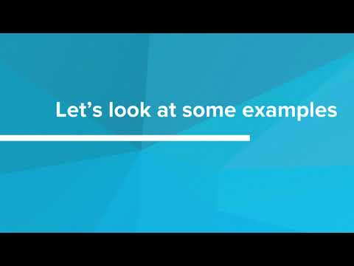
Using the Inspector

Slide 3
The Inspector would be a useful tool for which of the following tasks?
Starting to write the HTML and CSS based on a design
Testing what small CSS changes will do to the site presentation
Finalizing changes made to the styling of the website
All of the above

Slide 4
Open https://start.duckduckgo.com in a new window.
You will need to refer to it to answer the following questions.
Did you open https://start.duckduckgo.com in a new window or tab?
Yes
No

Slide 5
Open https://start.duckduckgo.com in a new window.
You will need to refer to it to answer the following questions.
Inspect the picture of the duck in the middle of the page.
You should see that it is actually a link (<a>).
What is this a tag’s class?
site-wrapper
logo_homepage_link
logo_homepage
tag-home

Slide 6
Open https://start.duckduckgo.com in a new window.
You will need to refer to it to answer the following questions.
What kind of element has the ID search_form_input_homepage ?
<table> in the main navigation
<p> underneath the search bar
<twitter>in the social media icons at the top
<input> in the search bar

Slide 7
Open https://start.duckduckgo.com in a new window.
You will need to refer to it to answer the following questions.
What is the ID of the body tag?
page-index
body-home
pg-index
main-content

Slide 8
Open the website for the Nelson Mandela Metropolitan Art Museum in a new tab (link below).
http://www.artmuseum.co.za/
Did you open the website in a new window?
Yes
No

Slide 9
Inspect the menu item that says “The Museum” at the top of the page.
What did this web developer use to create the navigation bar?
<table>
<div>
<ul>
<p>

Slide 10
Use the inspector to inspect one of the exhibit tiles at the bottom of the page.
What did this web developer use to create these tiles?
<table>
<ul>
<p>
<h1>

Slide 11
Inspect the large picture in the middle of the page.
What class does this element have?
feature
header
main
caption

